Slide 1

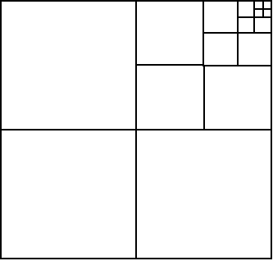
Quadtree Definition
  Tree data structure is appropriate to store composite key information, usually spatial data. Most often used to partition a 2d space or 3d space (oct-trees).
  Partitions space by recursively subdividing into 4 disjoint quadrants (or 2^{d} spaces when generalized).
  Quadtree implementations vary according to data represented including areas, points, lines (including polylines/curves).
Notes:
Veena

Slide 2
General Quadtree Properties
Decompose space into adaptable cells and each cell (or “bucket”) has a maximum capacity (or “threshold”).
When max capacity is reached the cell is split.
Algorithms for search are generally log_{d}N, where d is the dimensionality (4 for true quadtree)‏
Related to kd-trees, space is partitioned in rectilinear subdivisions. Difference is kd-trees always bisect space, while quadtrees quarter it
Notes:
Ryan

Slide 3
Types of Quadtrees
Trees (decompose data)‏
  Point Quadtree (Finkle, Bentley)‏
Tries (subdivision independent of data, decompose environ)‏
  Point-Region (PR) Quadtree (Gargantini)‏
    Really just a limited Region quadtree that simply stores points (disallows geometries that crosscut nodes such as lines, polygons, etc)‏
  Region Quadtrees (Samet)‏
    PM – stores points and lines (aka edges)‏
    PMR – stores arbitrary objects (images, lines, polylines, polygons, etc)‏
Notes:
Ryan
Trees represent parametric data, fully-parametric spaces
Tries represent non-parametric data (parameters are implied by position), non-parametric space

Slide 4
What types of data?
Generally
  low dimensional spaces (~< 5)‏
Point
  k-d dimensional point data
Point-Region (PR)‏
  above plus...
  bitmaps
Region (PM, PMR)‏
  above, plus...
  lines, polylines, polygons, solids, images
Notes:
Veena

Slide 5
What types of queries
  Point
    Point query
    Range query (e.g. window query, i.e. two or more bounds)‏
  Region
    Same as Point, plus...
    Intersection query or Region Query (find crossings for roads and rivers, i.e. polylines)‏
    Feature query (find constituent cells)‏
    Location query (given a cell, determination of identities of all contained/overlapping objects)‏
Notes:
Ryan

Slide 6
Example of queries
Example: space is 2d representation of earth surface where points are city centers and keys are x-y miles.
  Point queries:
    Find all cities north of Seattle (range query)‏
    Find all cities which are within 300 miles of Chicago (region search)‏
    What city is at position x-y (point query, or more powerfully nearest-neighbor)‏
Notes:
Veena

Slide 7
Point Quadtree
Data Organization
  Each node may have 4 children NW, NE, SW, SE (or 2^{d} children)‏
  Both leaves and non-leaves store data
  Only one point per node
  There is no unique solution for a given set of data (rather, order of insertion affects the tree)‏
  Nodes contain: position in N dimensional space, pointers to 2^{N} children, and data (or pointer to data)‏
  Representation decomposes the points (as opposed to the environment), i.e. representation stores parametric (“actual”) data on each node
Notes:
Veena

Slide 8
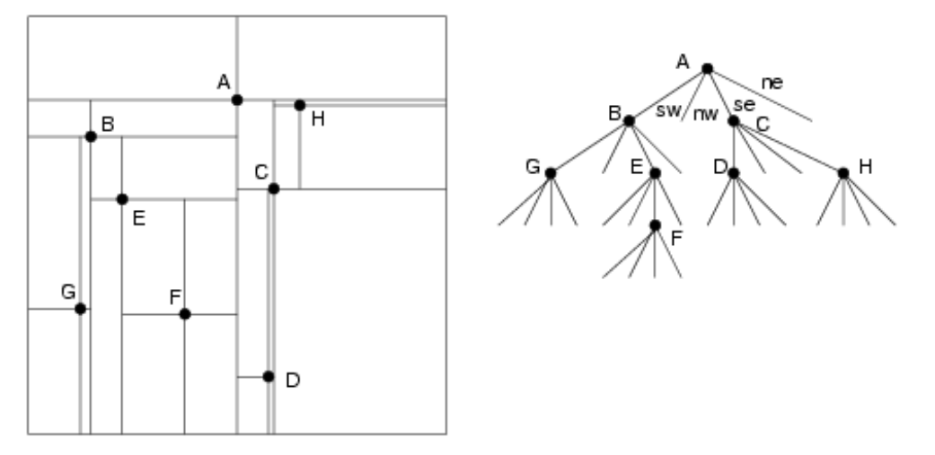
Point Quadtree
Data Organization (cont)‏
Notes:
Veena

Slide 9
How are queries processed?
Point search
  Is easy. Descend the tree looking for point (analogous to simple binary search).
  Average query time is total path length divided by number of points in tree or TPL/N.
    In balanced trees this should approach O(log_{d}N) if d is number of dimension, 4 for quadtree, e.g.
Notes:
Veena
Probably need to draw on the board to define what TPL is.

Slide 10
How are queries processed (cont)‏
Region search (for simple rectangle)‏
  Recursively descending search
    Asking if node is in region (if true add to output bin)‏
    Next asking node's quadrants overlap the region (if true recursively descend to child of quadrant)‏
  Complexity of the query varies. Empirically, the larger the number of nodes visited, the efficiency (or work performed) asymptotically reaches 1.0 or Visited/Found ~= work -> 1.0.
Region searches for other geometric shapes follow a similar methodology and performance.
Notes:
Veena
Draw example on board

Slide 11
Properties of Point Quadtrees
  Unlike all other forms, possible to make them perfectly balanced
    Bulk-loading may use median search to create optimal trees which are perfectly balanced.
  Deletion is hard and requires all children to be reinserted, n_{c} log_{d}(n_{c}) operations where n_{c} is number of children
  Non-optimized insertion is log_{d}(n)‏
  Queries for point search is log_{d}(n)‏
  Space complexity is simply N since each node represents a data point
Notes:
Veena

Slide 12
Region Quadtree
Data Organization
PR, PM_{{1,2,3}}, PMR are variations on a theme
  Each node may have 4 children NW, NE, SW, SE (or generally 2^{d} children)‏
  Only leaves store data
  Variants determined by data stored. PR is point data, PM is line data, PMR is arbitrary “object” data
  Representation decomposes the environment (as opposed to the objects)
  Generalized as Quad Tries (split by subset of key)‏
Notes:
Ryan
For PM variants, it is said objects are “clipped” to the region of each containing leaf block
the parts of object that intersect a leaf block are generally called “q-objects”, for lines they are called “q-edges”

Slide 13
Region Quadtree
Data Organization
PR, PM_{{1,2,3}}, PMR are variations on a theme
  PR
    Leaves store exactly one point
    Shape of the tree is independent of insertion order
  PM/PMR
    Leaves may store multiple lines/objects
    Lines/objects crosscut multiple nodes (or leaves)‏
    Shape of the tree somewhat dependent on insertion order
Notes:
Ryan

Slide 14
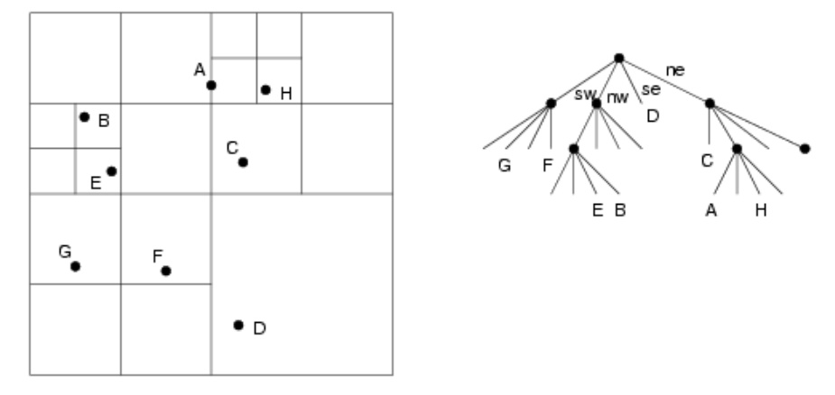
Region Quadtree
Data Organization (cont)‏
PR Quadtree (note partitioning is “regular”)‏
Notes:
Ryan

Slide 15
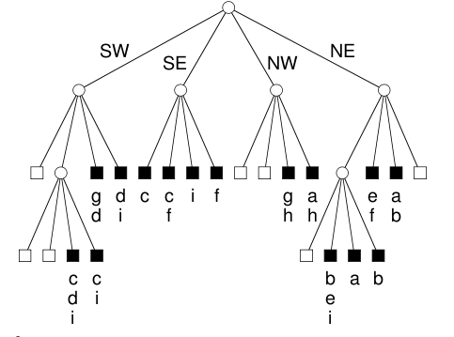
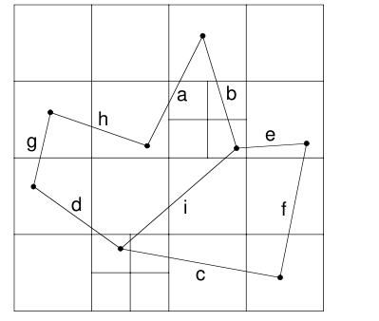
Region Quadtree
Data Organization (cont)‏
PM Quadtree
Notes:
Ryan

Slide 16
Region Quadtree
Data Organization (cont)‏
Leaf blocks advantage regularity of enclosing space by encoding placement on the tree
Entire tree may then be represented as a list of leaf blocks called a “linear quadtree”
Ultimately, linear quadtree may be stored in B-tree for conventional DB mechanics
Encoding may use Morton codes or Morton Block Index (MBI)‏
Notes:
Ryan

Slide 17
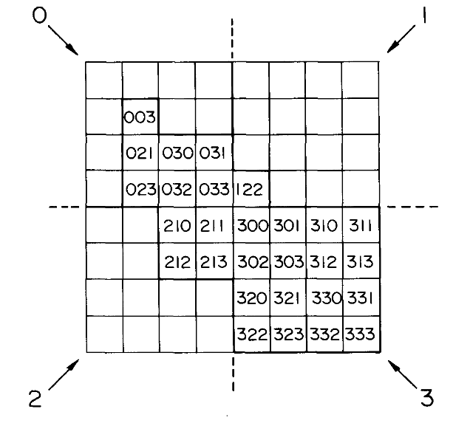
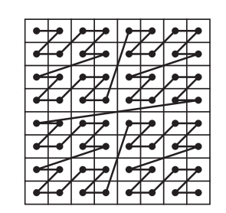
Linear Quadtree
Morton Block Index (MBI)‏
0 1 2 3 4 5 6 7
Position encoded in special form
In the example shown (y,x) of (6,5) is shown as “321”
This is a result of
Padding may be used so that Morton codes may be multi-level
0
1
2
3
4
5
6
7
read
binary
terms
down
110 = 6
101 = 5
-----
321
Space-filling curve:
Notes:
Morton code
Morton block value pair of numbers is Morton code and level
Sometimes referred to as Z-order
Ordering is “Stable” - subpartitioning a region does not invalidate the blocks already encoded
Note that order is arbitrary for instance 0 may be SW; thus SW, SE, NW, NE (or even SW, NW, SE, NE)‏

Slide 18
How are queries processed
  Point queries
    Encode point as MBI O(1)‏
    Binary search linear quadtree for MBI, O(log₂N)‏
  Feature queries (find object A)‏
    Scan linear quadtree searching “clipping” blocks, output is itself linear quadtree, O(N)‏
  Find all intersections of A and B queries
    Feature query on A and B, O(N)
    Merge join, O(M) (can be pipelined with above step)‏
Notes:
Ryan

Slide 19
How are queries processed
  Location queries (given cell, what am I?)‏
    Encode location as MBI, O(1)‏
    Find representative MBI block (if present); binary search on linear quadtree O(log₂N)‏
    Optional, followed by Feature queries on objects found
  Neighbors queries
    Locate boundary (location query)‏
    Calculate all neighbor cells using O(1) MBI modulo arithmetic, M*O(1) ~= O(M)‏
    Feature query on all neighbor cells
Notes:
Ryan

Slide 20
Properties of Region Quadtrees
  + May be used to store variable resolution images (additionally, resolution is easily truncated by chopping off deepest level)‏
  + Since data always stored in leaves, deletion has much less complexity than point quadtree
  + Many algorithms get to take advantage of linear quadtree which minimizes complexity
  + Further linear quadtree for some data types (e.g. bitmaps) may be compressed via MBI “condensation” technique
Notes:
Ryan

Slide 21
Properties of Region Quadtrees
  - Space complexity is dependent on data and required resolution (but linear quadtree may have good compression)
  - If data is not uniformly distributed in each dimension (or “patchy”) trees are unbalanced.
  - Two closely spaced points may lead to large depths
Notes:
Ryan

Slide 22
Other stuff
Bulk-loading/insertion may be made efficient by a combination of external merge sorting to strict Z-order (on data to be inserted), followed by procedures to build tree in memory and flush when memory is full.
Popular implementations
  Linear quadtree used in SAND, Oracle
  Spatial filling curve typically uses Morton coding (aka Morton Block Index)‏
Notes:
Veena

